Slide 1
BB Harris Elementary School 2013-2014 Casey Nestor Third Grade

Slide 2
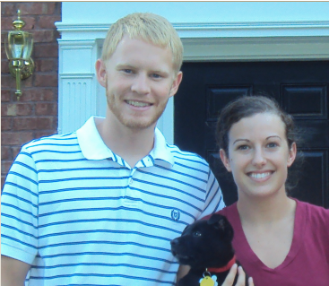
About Me
Born: Brevard, North Carolina on September 10
Grew up in Lawrenceville, Ga
Went to school in Gwinnett County from Kindergarten through 12th grade
Graduate of Collins Hill High School
Bachelors Degree in Early Childhood Education with a math endorsement from The University of Georgia
We live in Dacula.
Mr. Nestor, our school counselor, is my husband and we just got a new puppy this summer
Hobbies: spending time with family & friends, reading, playing tennis, scrapbooking, cooking, and watching movies

Slide 3
Who’s Who at Harris?
Principal - Dr. Lauri Burton
Assistant Principals – Elise Sheppard, Wendy Leo, Lynn-Dee Farmer
Focus Reading and Math Teacher- Faye Edwards
Counselor – Sean Nestor
Third Grade Teachers: Carrie Rice, Casey Nestor, Marlene Botts, Cheryl Walters, Inna Nakonechnyy

Slide 4
School Hours
Each school day begins at 8:50 and ends at 3:20 p.m.
If your child comes to school before the first morning bell at 8:20, they will need to go to the front entrance area.
The State of Georgia is focusing efforts on unexcused absences from school. Please have your child attend school daily and be on time.

Slide 5
Absences and Grading
Absences will not penalize student grades if the following conditions are met:
Absences are justified and validated for excused reasons.
Make-up work for all absences is completed satisfactorily.
(Although an absence may be considered “unexcused”,
make-up work for approved prearranged absences will
be permitted. Please note that vacations are NOT
excused absences!)
PLEASE SEND A NOTE FOLLOWING ALL ABSENCES

Slide 6
Daily Schedule
8:20-8:40 Arrival/Breakfast/Morning Work
8:40-9:00 Announcements/assignments
9:00-10:00 Reading
10:00-11:05 Writing
11:05-11:30 Lunch
11:30-12:40 Math
12:40-1:25 Specials
1:30- 2:15 Science/SS
2:15- 2:45 Word Work/Math Calendar
2:45-3:10 TDPE
3:15-3:20 Prepare for Dismissal

Slide 7
Classroom Policies
Students may have a water bottle at their desk.
A healthy afternoon snack is fine.
Work is to be completed on time. Third Grade Policy does not accept incomplete work from students unless it is due to an excused absence. Late will result in 10 points off.
If a child does not complete assigned work, the student will complete the work during outside time. A continued problem with incomplete work will result in further consequences as stated in the student handbook and Harris discipline plan.
Illegible work will be returned and will need to be rewritten.

Slide 8
Classroom Management
Consequences
Verbal Warning (S)
Isolation/ Refocus Sheet to be signed by parent (S)
Loss of T.D.P.E./Laps (N)
Conference with student/ Time out and think sheet/ Loss of complete recess or silent lunch. Phone call or note home (U)

Slide 9
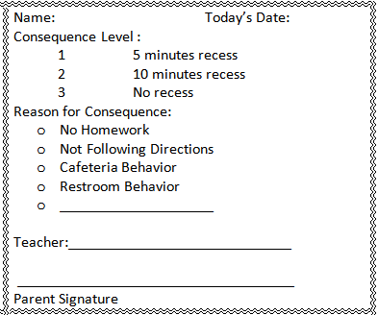
Classroom Management

Slide 10
IMPORTANT
Homework should not be a parent-child struggle at this age. Creating a specific time each night and providing an environment for learning will help. It is also helpful to set time limits for students who procrastinate. Personal responsibility is important at this age.
Students should read for at least 20 minutes each night.
All medicine must be taken to the clinic, including cough drops.
Breakfast is served in the classroom. Students may sign up each day by 8:35 if breakfast is desired. The breakfast menu can be found on the school’s website.

Slide 11
Third Grade Grading Policy
READING
Performance Assessment(Reading Rubric) 50%
Daily Work 15%
Homework 5%
Skills Assessment 27%
Interim 1 3%
WRITING/GRAMMAR
Written Expression 50%
Grammar, Usage, Mechanics 45%
Homework 5%
SPELLING
Performance Assessment 50%
Skills Assessment 30%
Daily Work 15%
Homework 5%

Slide 12
Grading Policies Continued
MATHEMATICS
Daily Grades 45%
Homework 5%
Assessments 47%
Interim 1 3%
SCIENCE/ SOCIAL STUDIES
Daily Grades 50%
Assessments 47%
Interim 1 3%
HEALTH (E,S,N,U)

Slide 13
Classroom Management Rewards
Compliment Chart: The class can work together to earn Popcorn parties, free-time, computer time, and other rewards decided upon by students.
Individuals may receive small treats, candy, treasure box, homework passes, and other rewards at random.
We use the clip system where students can move clips up for good behavior and down for behavior that needs redirection.

Slide 14
CRCT
Georgia law requires all students in all grades 1-8 take the CRCT in the content areas of reading, language arts and math. The tests are designed to measure how well the students are acquiring and learning the Georgia Performance Standards.
Students in 3rd grade must achieve “Meets” or “Exceeds” on the CRCT in Reading

Slide 15
Important Dates
¨CRCT Testing Dates: April 23-29
¨CogAt Testing Dates: September 16-20
¨ITBS Testing Dates: October 21-25

Slide 16
Parent Conferences
Early Release Conferences are:
September 25 and 26
During parent conferences your child’s progress will be discussed.
I can be reached during school hours at: (770) 476-2241
The best way to reach me is email:
Casey_Nestor@gwinnett.k12.ga.us
The best form of communication is email. Please provide me with an email address if you haven’t already.
www.nestor3.weebly.com

